Slide 1
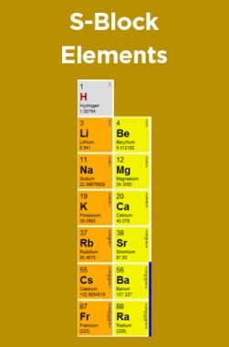
S- BLOCK ELEMENTS

Slide 2
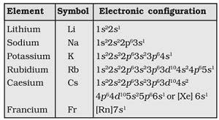

Slide 3
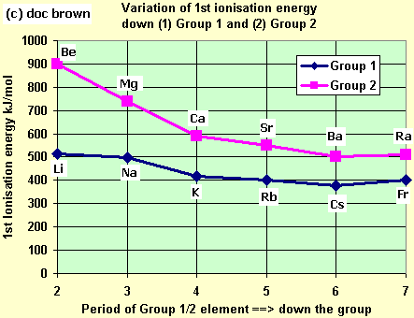

Slide 4
hydration enthalpy is inversely proportional to size. Size increases as we go down the group due to addition of more shells. Hence we can say that hydration enthalpy is maximum for lithium cation amongst the group 1 elements.

Slide 6
∆EO = ∆ IE H + ∆ A H - ∆ HYD H

Slide 7
CHEMICAL BEHAVOIUR

Slide 8
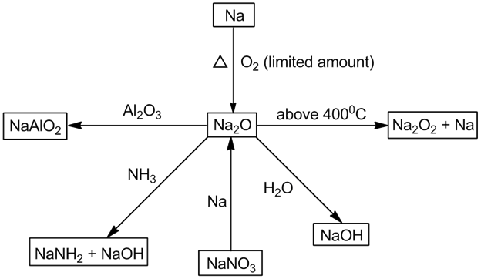

Slide 10
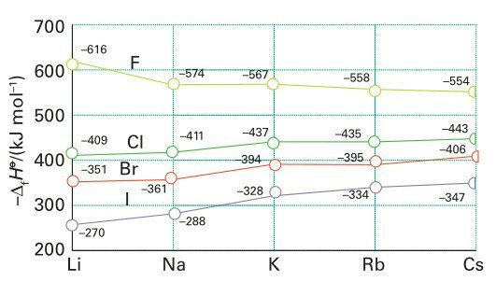

Slide 11
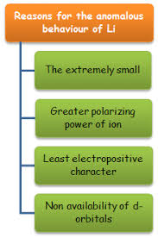

Slide 12
